Slide 1
Student Placement App
By – Patel Tirth (tnp)

Slide 2
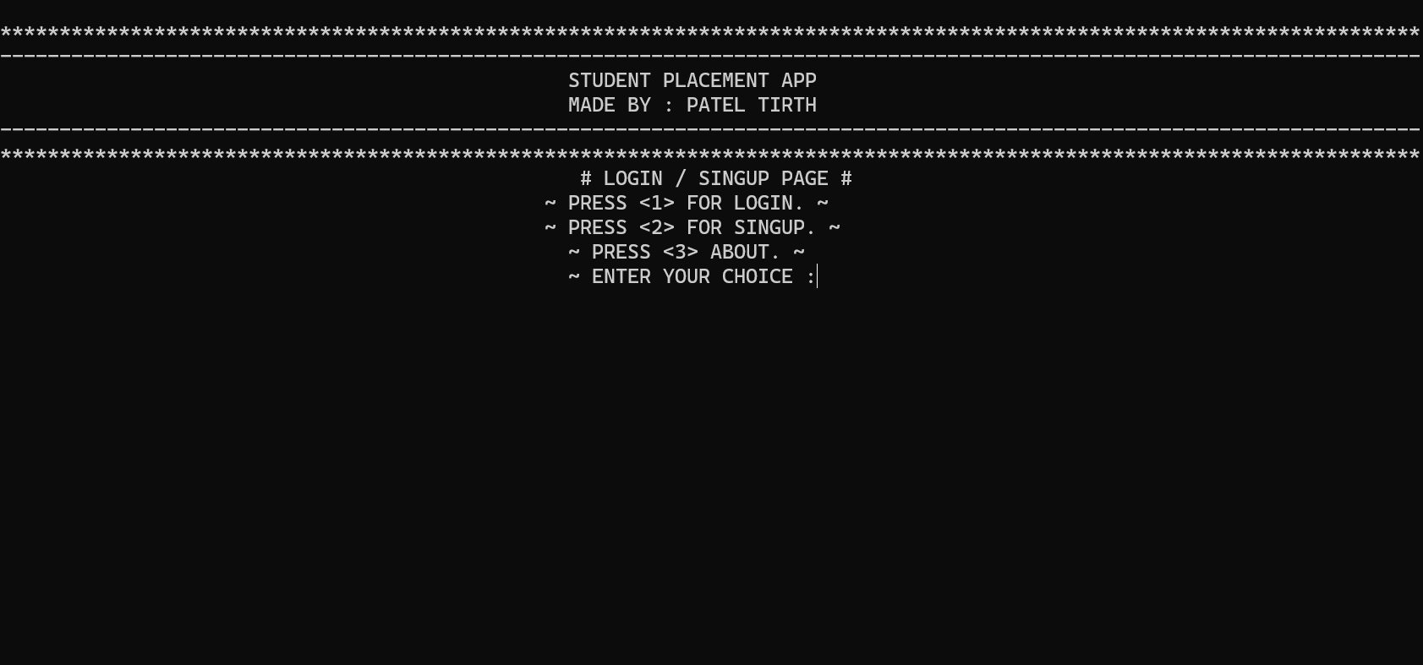
Choice Selection Page….

Slide 3
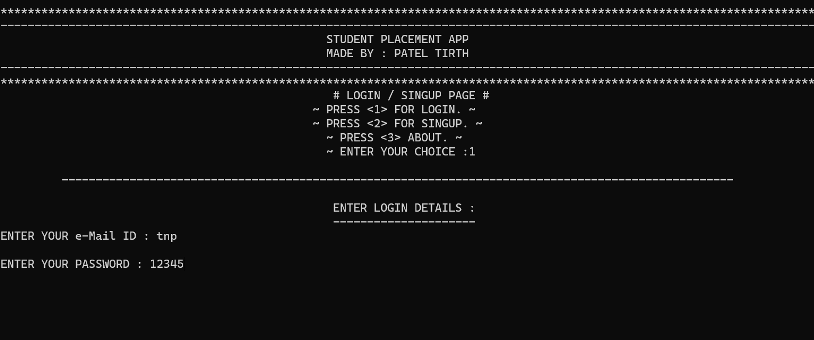
Login Page….

Slide 4
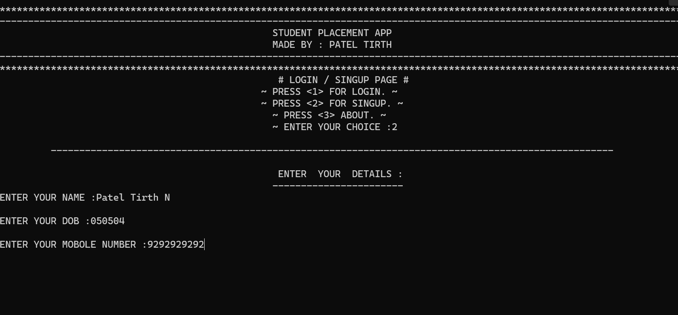
Singup Page….

Slide 5
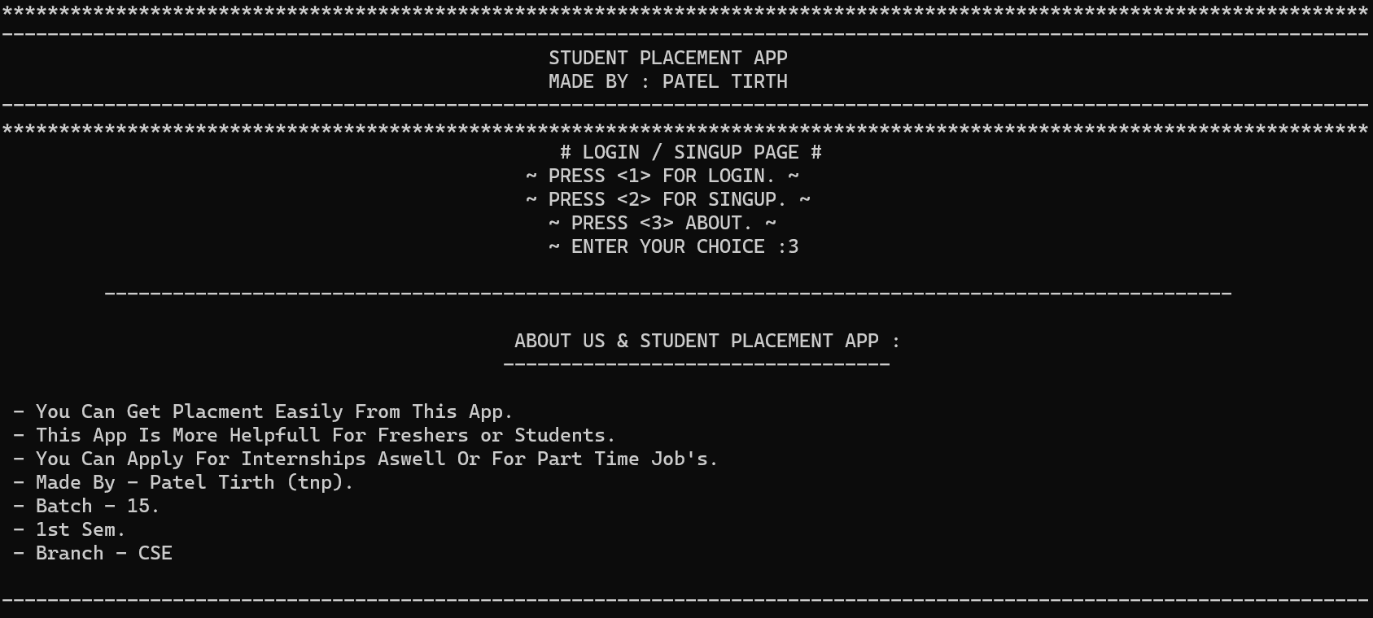
About Us & Student Placement App Page….

Slide 6
Student Placement App
BY – Patel Tirth (tnp)
Batch – 15
CSE 02
1st Sem

